Slide 1


JERUSALEM COLLEGE OF ENGINEERING
DEPARTMENT OF CSE
Recommendation Systems in Big Data Analytics
Prepared by Ms.J.Rajeshpushpa
AP/CSE

Slide 2



What is a Recommendation System?
A subclass of information filtering systems that seeks to predict the "rating" or "preference" a user would give to an item.
Goal: Solve information overload by filtering vital information.
Business Value: Increases sales, user engagement, and customer retention.
Application: Ubiquitous in e-commerce (Amazon), streaming (Netflix), and social media (TikTok).

Slide 3






The Big Data Connection
Volume
Velocity
Variety
Systems must process terabytes of data. Matrix factorization becomes computationally expensive with millions of users and items.
Real-time recommendations require low-latency processing of streaming data (clicks, views) to update models instantly.
Beyond ratings! Modern systems ingest unstructured data like text reviews, social media logs, and image metadata.

Slide 4

Types of Recommendation Systems
Collaborative, Content-Based, and Hybrid Architectures

Slide 5
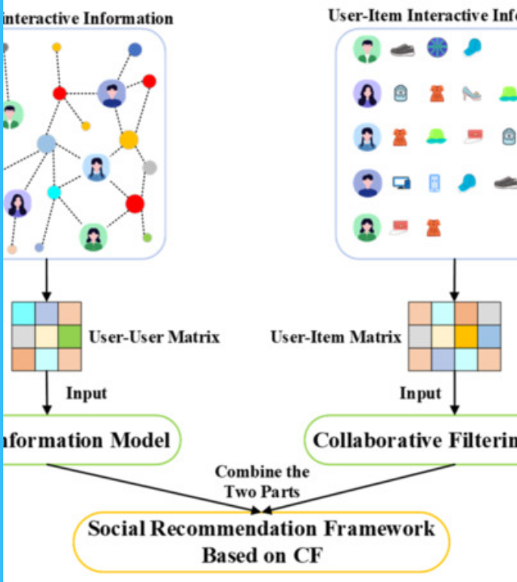
Collaborative Filtering
Premise: "Users who agreed in the past will agree in the future."
It builds a model from a user's past behavior (items previously purchased or selected) as well as similar decisions made by other users.
User-Based: Find similar users to me, recommend what they liked.
Item-Based: Find items similar to what I liked (based on other users' ratings).
Advantage: Capable of recommending complex items without understanding the content itself.

Slide 6


Content-Based Filtering
Item Profile
User Profile
Items are described by a set of keywords or attributes. For a movie, this could be Genre, Director, Actors, or Plot keywords.
A profile is built to indicate the type of items this user likes. This is often a vector of weights corresponding to the item features.
Example: Movie A = {Action, Sci-Fi, 1999}.
Logic: If a user reads many articles about "Big Data", recommend more articles with the tag "Big Data".

Slide 7

Hybrid Systems
"Most modern recommender systems, including Netflix and Amazon, use hybrid strategies to leverage both user interaction history and rich item metadata."
The Best of Both Worlds
Hybrid approaches combine collaborative and content-based methods to overcome the limitations of each.
They are particularly effective at solving the "Cold Start" problem where new items lack user interaction data.
Weighted: Score = (A * Content) + (B * Collaborative)
Switching: Use Content-based for new users, switch to Collaborative later.

Slide 8
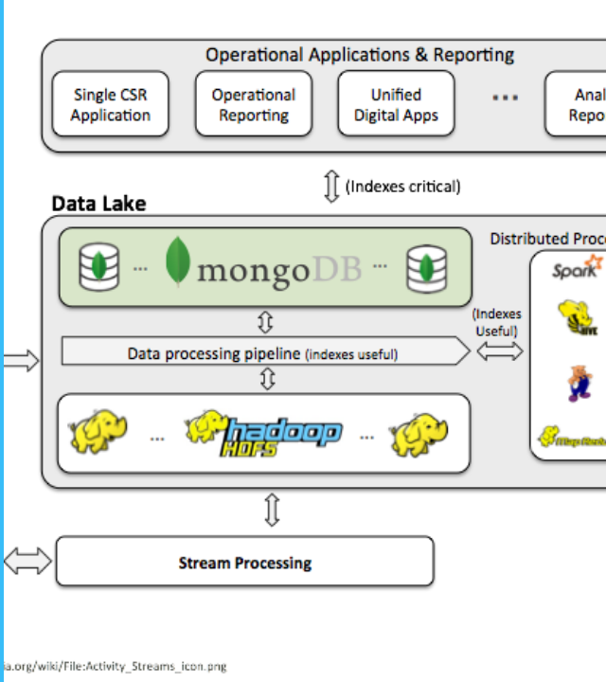
Big Data Architecture
A robust pipeline is required to handle the 3Vs. The architecture typically consists of ingestion, storage, processing, and serving layers.
Ingestion: Kafka / Flume for streaming logs.
Storage: HDFS / S3 (Data Lake) for raw data; Cassandra / HBase for real-time lookups.
Processing: Spark MLlib for batch training (Matrix Factorization); Spark Streaming for real-time updates.

Slide 9
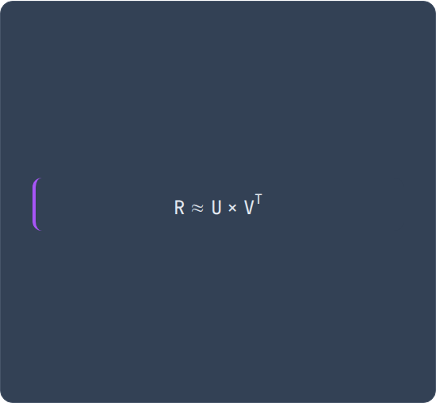


Core Algorithms: Similarity
Cosine Similarity
Matrix Factorization
Measures the cosine of the angle between two non-zero vectors. Used to find similarity between User vectors or Item vectors.
Decomposes the User-Item interaction matrix (R) into two lower-dimensional matrices: User Factors (U) and Item Factors (V).
Solved using ALS (Alternating Least Squares) in Spark.

Slide 10



Key Challenges
Cold Start
Scalability
Data Sparsity
Difficulty in recommending to new users (no history) or recommending new items (no ratings). Solved via Hybrid methods.
Computing similarity for millions of user pairs is O(N^2). Requires distributed computing (Spark) and dimensionality reduction.
Users rate only a tiny fraction of items. The matrix is 99% empty, making it hard to find reliable neighbors.

Slide 11
Evaluation Metrics
Ranking Metrics
Accuracy Metrics
Used for generating "Top-N" lists.
Used for predicting ratings (e.g., 1-5 stars).
Precision@K: What % of the top K recommendations were relevant?
RMSE (Root Mean Squared Error): Penalizes large errors more heavily. Standard for Netflix Prize.
Recall@K: What % of relevant items appeared in the top K?
MAE (Mean Absolute Error): Average of absolute differences between predicted and actual ratings.
MAP (Mean Average Precision): Accounts for the order/rank of relevant items.

